Slide 1


What is Fear? What is reward?

Slide 2
SIMPLE ACTIVITY BEFORE WE GET STARTED…..
Sketch the electrical circuit (or pathway) that starts your car. The sketch should include switch (when you insert the key in ignition), to ….. to …..
Or you can sketch any other electrical pathway in a car or in your house, etc. that is of interest to you.

Slide 3
We all have experienced feelings of fear and different types of fear. These fears can range from being scared when you see a hot stove nearby to the fear of heights…..both due to the harm it can cause you if the hot stove burns you, or if you fall from the heights!
Now, is fear an emotion that we instinctively possess or is it learned?
Fear is of two types – innate(e.g., fear of heights) and learned (e.g., not to touch a hot stove)
Innate fear is not well understood in mammals and is a topic of research presently. Here, we will focus only on learned fear. Note that learning of such fears occurs subconsciously, i.e., the subject is not aware that they are learning the fear. For instance, when a kid learns that 2x3 =6, they are aware they are learning it. Not so in the case of fear!
Consider the case of touching a hot stove. When we do not know a hot stove would cause pain, we touch it without fear the first time. However, we will experience pain during the first touch. This sensation is caused by temperature and pain sensors in our fingers via a neural pathway that connects it to the brain. After touching a hot stove for the first time and experiencing pain, we learn to associate the hot stove with pain. That is, we “learn” to fear touching hot stoves. What changes in the neural pathways in our nervous system and/or brain that is responsible for “learning” this fear?
Such learning can occur with pizza too, i.e., when you first eat pizza you love it, and when you see pizza next time, your mouth waters! Neuroscientists have been trying to investigate the neural pathways that implement this ‘associative’ learning which we will first explain using Pavlov’s famous experiment with dogs!

Slide 4
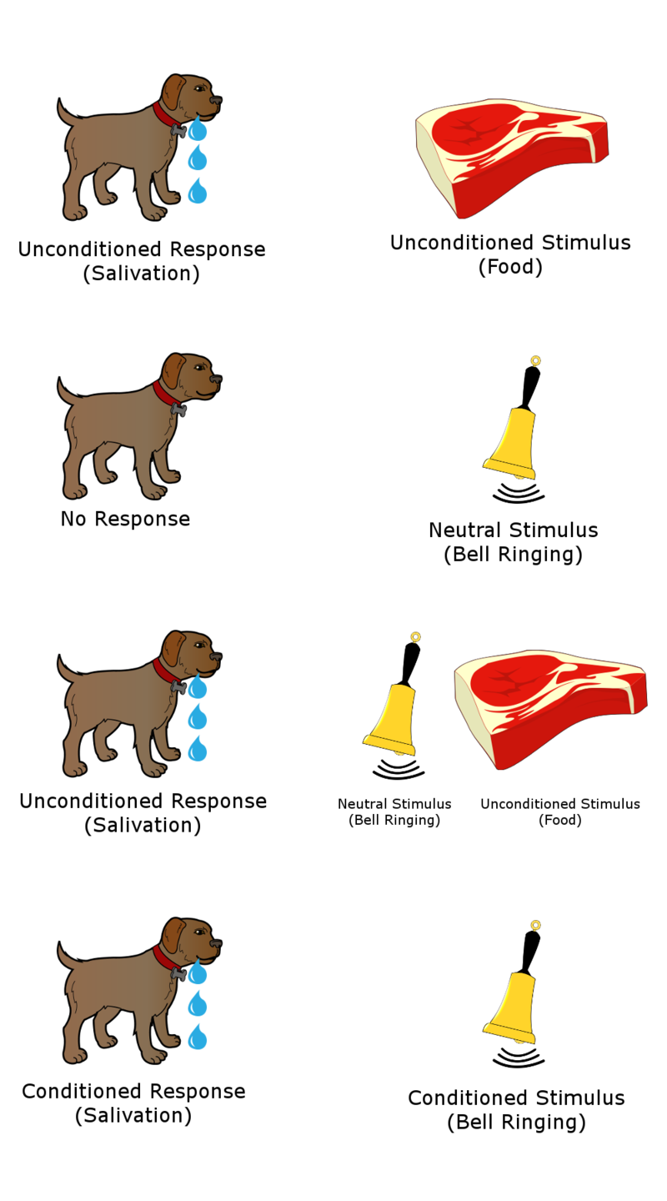
What is reward? ….Pavlov’s famous conditioning experiment with dogs!
Pavlov devised an ingenious method in 1897 to find out how we may learn to associate neural stimuli (e.g., such as bell ringing; also termed conditioned stimuli) to unconditioned stimuli such as food.
To explore the neural pathways that might be implementing “learning” to associate conditioned stimuli (such as sound, smell, light….) to unconditioned stimuli such as food or fear, scientists have been using the Pavlovian paradigm. So, we first consider the Pavlovian experiment and learn about all the terms involved – note that he worked this out in 1897!
VIDEO - Pavlov’s famous conditioning experiment for reward learning.
https://en.wikipedia.org/wiki/Classical_conditioning

Slide 5
Pavlovian auditory fear (similar for reward) conditioning – An experiment to train rats to fear a particular sound
First, you have to know that when a rat is fearful, it will either freeze or run. If a rat is in a cage, it cannot run, and so fear in a cage is exhibited by freezing. The level of fear is scored by noting how long a rat freezes – automated programs are available to score this using the experiment video. Different rodents exhibit different levels of fear, as also with humans.
The rat fear conditioning experiment is as follows:
(1) Rat will first hear a tone (sound) by itself and gets habituated to it and ignores it after some time.
(2) In the next stage, the rat then hears the same tone but this time it will be accompanied by a shock causing it to feel pain. This is called a ‘conditioning trial’. The number of conditioning trials typically varies from 5 to 10 depending on the intensity of shock.
(3) After the conditioning trials, the rat will again hear the tone by itself and its fear will be scored automatically using video frames.
Can you guess the rodent response after conditioning (3) as compared to before conditioning (1)? Watch the following 1-minute video for the answer:
https://www.youtube.com/watch?v=mi2gqhHw1N0

Slide 6
Tone-shock fear conditioning in rodents – contd.
After watching the fear conditioning video, can you guess why the rats behaved differently after conditioning? What neural pathways may have changed and what specific changes occurred?
Jot down your thoughts.

Slide 7
Neurons connect to each other via synapses
Tone comes in as a series of spikes or electrical impulses from the neuron in the sensory neuron in the ear
The axon of the tone neuron connects to the amygdala neuron via a synapse shown in the figure – two semi-cylindrical pieces with a gap in between.
The synapse has two parts, the left side is called pre-synapse and it is connected to the tone neuron, and the right part is called the post-synapse that is connected to the amygdala neuron
The electrical impulse is transmitted from the pre- to the post- synapse via neurotransmitters. This is the role of the synapse, i.e., transmit electrical impulses from one neuron to another.
Let us see how this information can be used to study the two neural pathways. One is between tone and the amygdala and the other is between shock and the amygdala.
Optional – if you are interested, you can learn more about synapses using web resources.
Axon from tone neuron
Synapse
Amygdala neuron

Slide 8
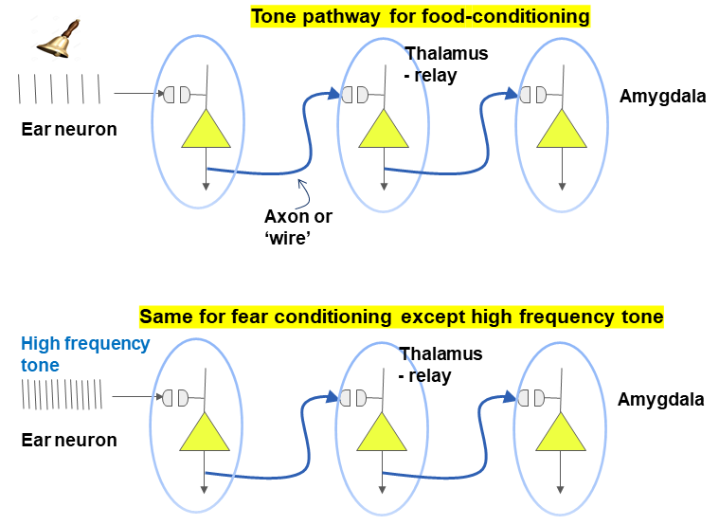
What is the neural pathway for the tone – reward and fear cases?
The pathway for food stimulus and for shock stimulus is similar.
Can you sketch them for the fear conditioning case?

Slide 9
What is fear conditioning?
RECAP --- In our experiment, the rats appeared to initially not respond to the tone and continue their behavior without any type of response. During the “fear conditioning” phase, the tone co-terminated with a shock, i.e., tone and shock were paired. After such pairing, the rats started to freeze after hearing only the tone.
Why did the rats freeze?
The rats froze because they had learned to associate the tone with shock during the conditioning trials. That changed something in the neural pathways related to fear. This is why subsequent presentations of only the tone, i.e., without shock, caused the rats to get into the fear state and freeze.

Slide 10
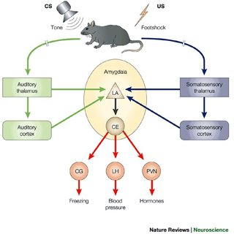
How is the brain involved in learning fear?
The brain is a complex organ responsible for thinking, emotion, memory, vision, and several processes that allow the body to function – and is the “computer of the body”
There is part of the brain called the amygdala that is involved in processing and learning fear.
The schematic shows how the amygdala was involved in the tone and shock experiment. Amygdala interacts with several regions and is thought to implement behavioral responses via projections from its output site (Ce nucleus).
These are the neural pathways and regions that implement fear! We will study more about neural pathways in later activities.
OPTIONAL- the output from Ce goes to periaqueductal gyrus (PAG) to implement freezing, to lateral hypothalamus to increase blood pressure and paraventricular nucleus to release hormones. This lecture will only focus on the initial pathway.

Slide 11
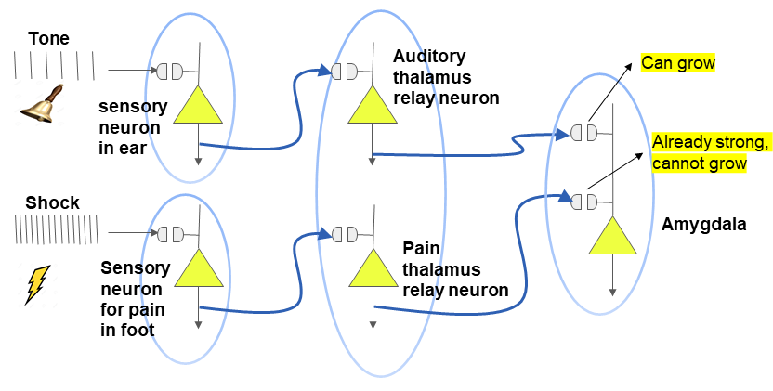
Both tone and shock pathways together

Slide 12
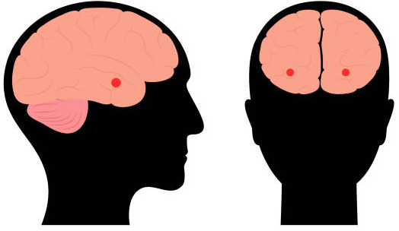
Side View
Front View
Humans have two almond sized amygdala on either side of your head, shown in red in the figures on the left

Slide 13
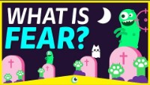
What is FEAR and why do YOU feel Scared? (4.5 min) Beautiful Science

Slide 14
ACTIVITY – 1 (Sketching)
In the rodent fear conditioning video that you saw, the tone enters the brain via the ear and travels to the amygdala as electric impulses (spikes), via the axon (like a wire). The shock enters the brain via the foot of the rodent and also goes to the same amygdala neuron via its own axon. All sensory signals typically go through a region of the brain called the thalamus, which is essentially a relay station.
TO DO:
Sketch a human face in the front view and show the almond shaped amygdala on the left and right sides (in your brain too!)
Sketch the tone neural pathway, with one neuron in the ear, one neuron in the thalamus (relay station) and one neuron in the amygdala.
In the same figure, now sketch the shock neural pathway, with one neuron in the foot, one in the thalamus and going to the same neuron in the amygdala.

Slide 15
ACTIVITY – 2
YOUR CHALLENGE: Go into the virtual lab provided at the link below https://phet.colorado.edu/en/simulations/circuit-construction-kit-dc and click on the play button to get started
Then build two separate electrical circuits : one for the tone pathway and another for the shock pathway. How do they differ?
Hint - you will need a battery, a wire, a resistor, and a light bulb
After they are done, show them the breadboard circuit with one circuit – battery, wire, resistor and light bulb or LED. Explain how that works, to consolidate their understanding of a circuit or pathway.
Solution for the teacher is provided at the end of this set of slides

Slide 16
ACTIVITY – 3 Reward Conditioning
In this activity, you will use a Colab notebook (select D1.1.ipynb) to comprehend how the amygdala fires in response to amygdala signals reward in the case of a bell ring when it has previous been paired with a reward of food.
url for colab notebook: https://github.com/KhuramC/Fear-Lesson-Plans
You will thus learn about how reward is learned at the neuronal and neural pathway levels.
TO DO:
Adjust the given values to get the amygdala neuron (a different one from the fear neuron) to fire at the baseline value of < 0.5 Hz (once in 2 seconds)
Adjust the given values to get the amygdala to signal food, i.e., fire at a value of approximately 5 Hz (five times per second). Note that this represents a different neuron from the fear one.

Slide 17
ACTIVITY - 4
In this activity, you will use the Colab notebook titled “D1.1:1-cell model of amygdala” to comprehend how the amygdala fires in response to sound during the baseline state, e.g., when you hear music that you like. You will then find out how the amygdala signals fear for the same sound when it has previous been paired with a scary outcome, i.e., shock.
You will thus learn about how fear is learned at the neuronal and neural pathway levels.
TO DO:
Adjust the given values to get the amygdala neuron to fire at the baseline value of < 0.5 Hz (once in 2 seconds)
Adjust the given values to get the amygdala to signal fear, i.e., fire at a value of > 7 Hz (seven times per second)

Slide 18
Conclusion
We learned about the neural pathways that cause us to fear. And that fear can be both innate and learned.
We learned about Pavlovian reward conditioning with the dog. And also learned about Pavlovian fear conditioning and how it was applied in an experiment involving rats using a tone, and shock.
We explored the neural pathways in the mammalian brain that are responsible for learning reward/fear and how the amygdala responds to fear. Specifically, we focused on the pathway that goes from sensory neurons to the thalamus and then to the amygdala. Later tutorials will build on this and provide details.

Slide 19
Why should this interest me? The fear circuit is also involved in mental health disorders such as ANXIETY, PHOBIA, etc.…. Not understood presently and so an attractive area for research in your career if interested.
What is fear?
Fear is a response to an immediate threat; activates the flight-or-fight response; results in increased heart rate and blood flow
What is anxiety?
Anxiety is apprehension about a future threat; causes muscle tension, vigilance, caution or avoidant behavior
What is phobia?
Phobia is persistent, unrealistic and intense fear of a specific stimulus; causes avoidance behavior

Slide 20
References and additional reading
Mobbs D, et al., On the nature of fear (Oct 10, 2019) Scientific American
Joseph LeDoux, Redefining fear APS William James Fellow Lecture 2015)
Insel T, Faulty Circuits, Scientific American, 2010

Slide 21
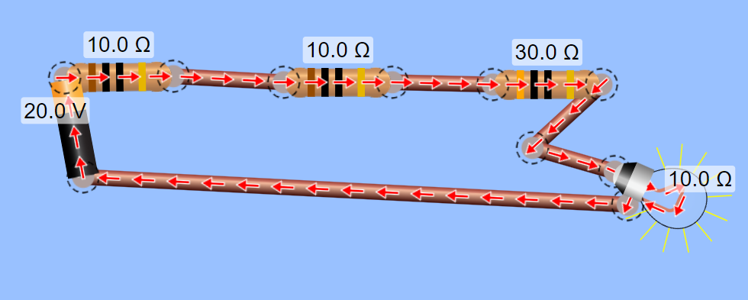
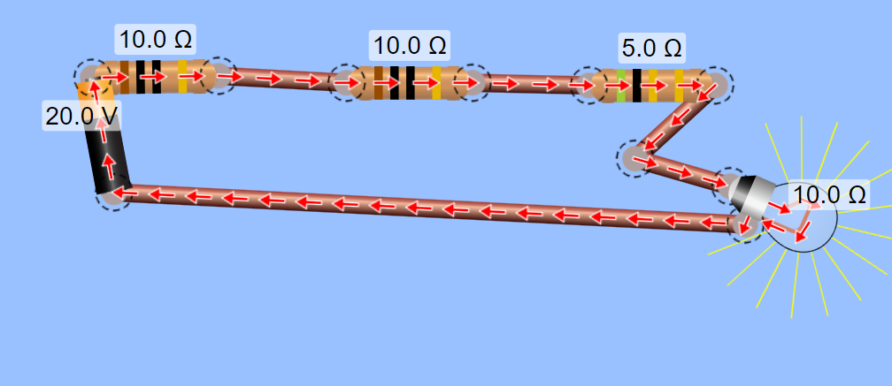
Solution to Activity 2:
Top – tone pathway,
Bottom – shock pathway
Note: Bulb is brighter in the shock pathway, i.e., mimics amygdala firing at a higher rate of 7 Hz

